Slide 1






PREDICTIVE MODELLING AND ANALYSIS OF HOSPITAL INPATIENT STAYS AND COSTS USING SPARCS DATASET

Slide 2

Introduction
Background on SPARCS:
SPARCS: Statewide Planning and Research Cooperative System
Established in 1979
Collects data on hospital admissions and discharges in New York State
Objectives of the Analysis:
Gain insights into factors influencing hospital inpatient stays and costs
Examine relationships between patient demographics, diagnoses, procedures, and hospital characteristics
Focus on predicting total costs and length of stay
Problem Statement and Research Questions:
Can we predict total costs associated with a hospital inpatient stay?
Is it possible to predict the length of stay for a patient?
By answering these questions, we aim to provide actionable insights to improve cost-effectiveness, resource allocation, and patient care.

Slide 3
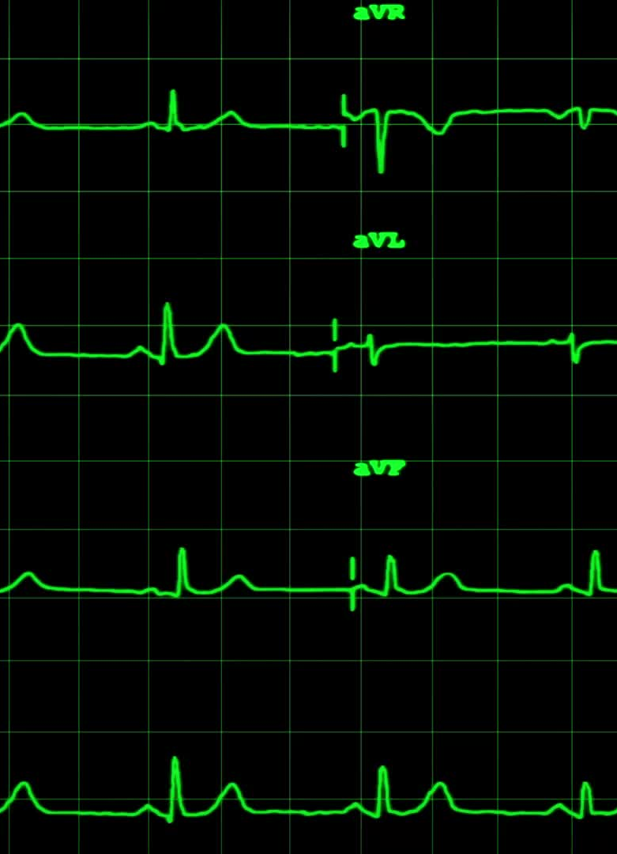
Overview of the Dataset
"Hospital Inpatient Discharges (SPARCS De-Identified)" dataset
2,345,070 rows and 34 columns
Each row represents a single hospital inpatient discharge
Columns include:
Patient demographics
Diagnosis codes
Procedure codes
Hospital information
Financial data

Slide 4
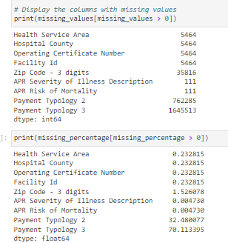
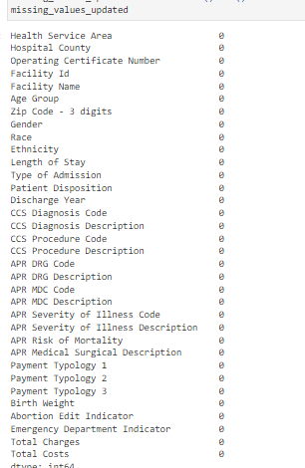
Handling Missing Values
Initial analysis revealed missing values in several columns
Imputation strategies: Mode imputation for low percentage missing values for 'Not Available' category and for 'Payment Typology 2' and '3'
Before Handling Missing Values
After Handling Missing Values

Slide 5
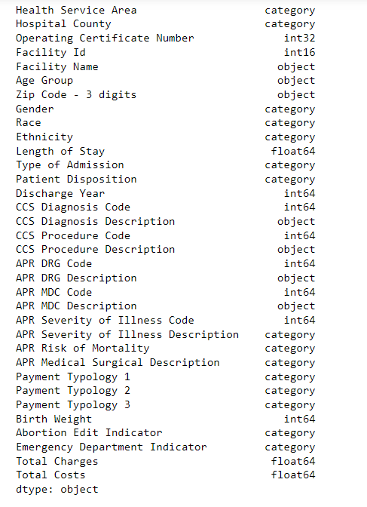
Data Type Conversion
Converted 'Operating Certificate Number' and 'Facility Id' to int32 and int16
'Length of Stay' converted to float64

Slide 6
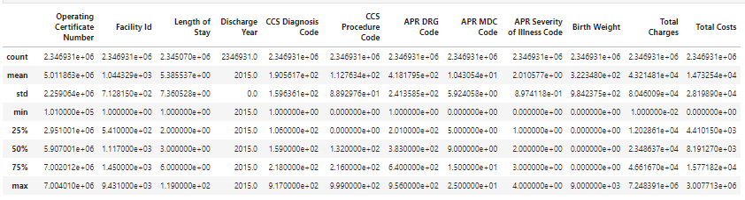
Descriptive Statistics
Key Numerical Variables: Length of Stay:
Mean: 5.39 days
Standard Deviation: 7.36 days
Min: 1 day, Max: 119 days
Total Charges:
Mean: $43,214.81
Standard Deviation: $80,460.09
Min: $0.01, Max: $7,248,391
Total Costs:
Mean: $14,732.54
Standard Deviation: $28,198.90
Min: $0, Max: $3,007,713

Slide 7
Analysis of Categorical Variables
Geographic Distribution:
Majority of discharges in New York City (1,096,733)
Highest discharges in Manhattan, Kings, Queens, Bronx, and Nassau counties
Patient Demographics:
Females (1,307,574) had more discharges than males (1,039,309)
White patients (1,334,890) largest racial group
Non-Spanish/Hispanic (1,954,846) majority ethnicity
Admission Characteristics:
Emergency admissions (1,487,948) most common
Home or self-care (1,572,079) primary disposition
Medical and Surgical Classifications:
Moderate severity (897,411) most prevalent
Medical stays (1,779,268) more common than surgical (567,552)

Slide 8
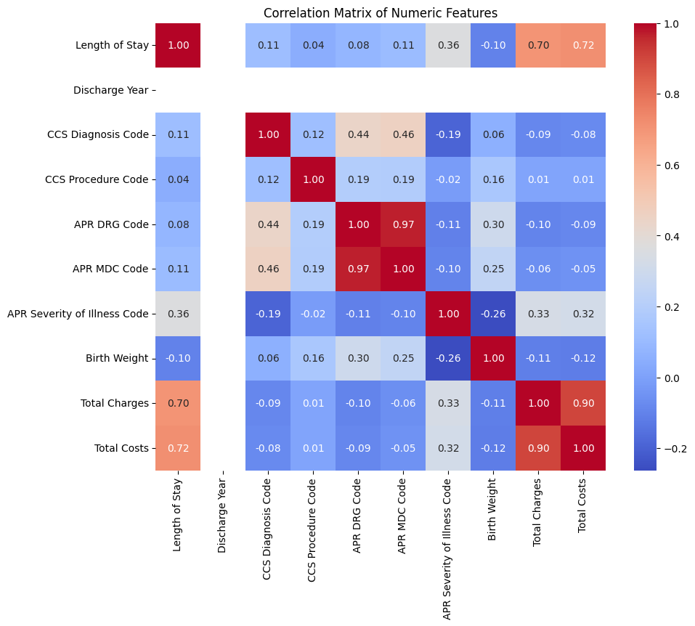
Correlation Analysis
Length of Stay:
Strong positive correlation with total charges (0.701230) and costs (0.717270)
Moderate positive correlation with APR severity of illness code (0.362886)
Total Charges and Total Costs:
Strong positive correlation with length of stay
Moderate positive correlation with APR severity of illness code
Total charges (0.330829)
Total costs (0.315720)
APR DRG Code:
Very strong positive correlation with APR MDC code (0.968579)

Slide 9
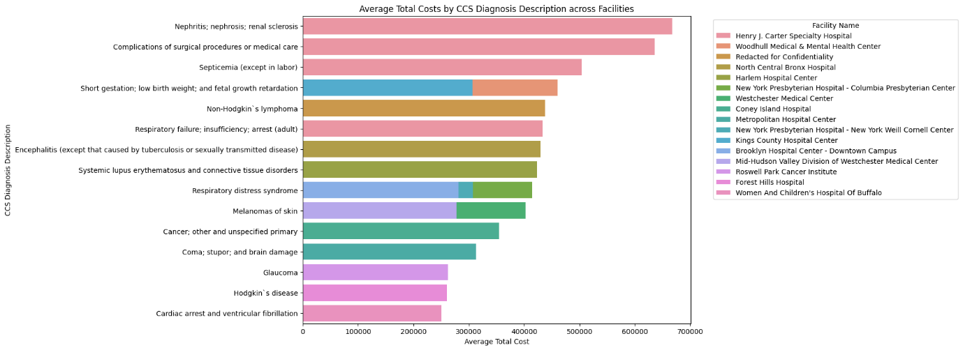
Relationship between Total Cost and CCS Diagnosis Description across Facilities
Highest Average Total Cost:
"Nephritis; nephrosis; renal sclerosis" at Henry J. Carter Specialty Hospital ($667,453.14)
Complications and Infections:
"Complications of surgical procedures or medical care" at Henry J. Carter Specialty Hospital ($636,134.82)
"Septicemia (except in labor)" at the same facility ($504,184.41)
Neonatal and Pediatric Conditions:
"Short gestation; low birth weight; and fetal growth retardation" at Woodhull Medical & Mental Health Center ($460,263.02)
"Respiratory distress syndrome" at New York Presbyterian Hospital - Columbia Presbyterian Center ($414,651.60)

Slide 10
Prediction Modeling 1: Predicting Total Costs
Problem Statement and Analysis:
Predict total costs associated with a hospital inpatient stay
Utilize patient demographics, admission type, length of stay, diagnosis, procedures performed, severity of illness, and hospital characteristics
Leverage machine learning techniques to build predictive models
Assess feasibility and accuracy of predicting total costs

Slide 11
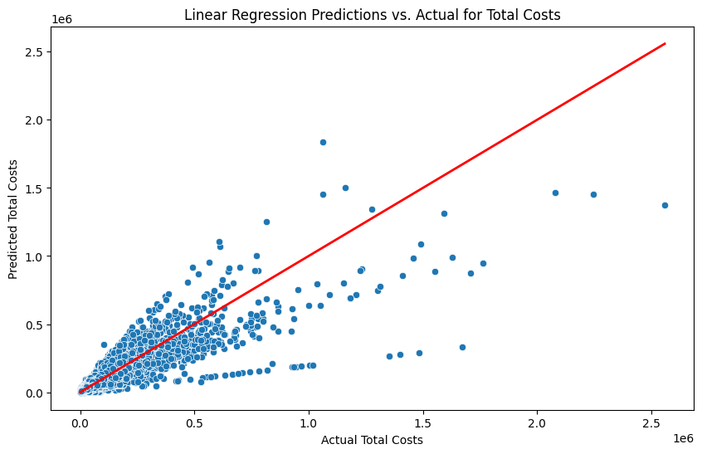
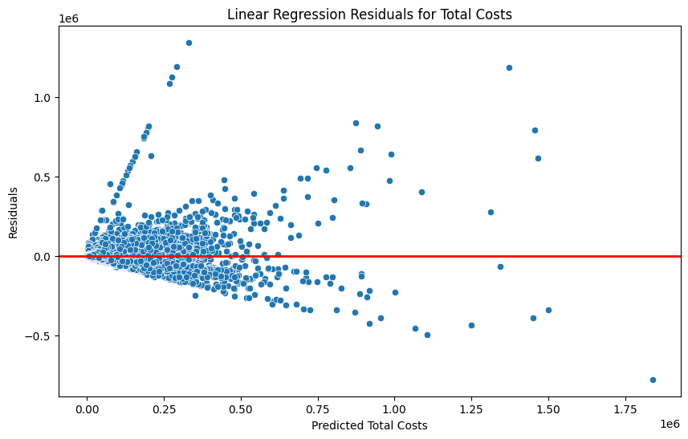
Linear Regression Model
Model Overview:
Assumes linear relationship between input features and target variable
Predict total costs based on available features
Performance Metrics:
MAE: 4264.45
MSE: 144006157.98
RMSE: 12000.26
R-squared: 0.8205

Slide 12
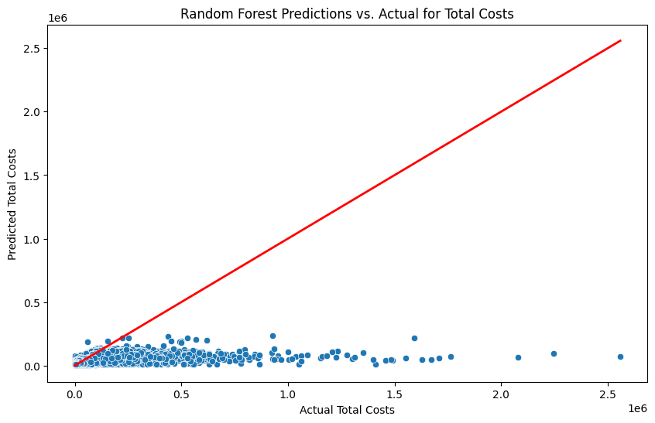
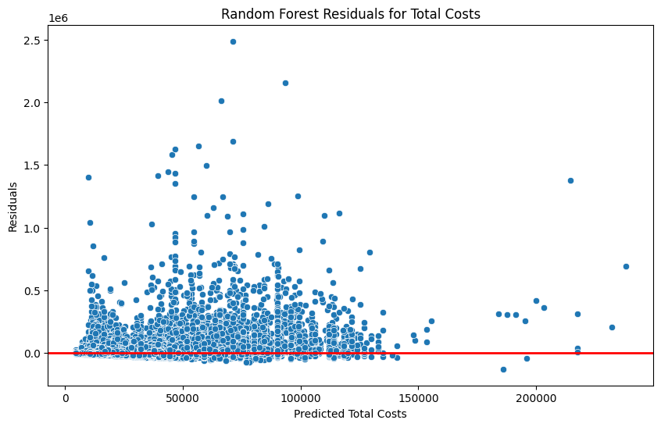
Random Forest Model
Model Overview:
Ensemble learning algorithm combining multiple decision trees
Capture non-linear relationships and handle complex interactions between features
Performance Metrics:
MAE: 8646.48
MSE: 536945710.04
RMSE: 23172.09
R-squared: 0.3305

Slide 13

Model Performance Comparison
Linear Regression Model:
Lower MAE and RMSE, indicating smaller average prediction errors
Higher R-squared value, explaining 82.05% of the variance in total costs
More linear trend in predicted vs. actual costs plot
More even distribution of residuals around zero line
Random Forest Model:
Higher MAE and RMSE, indicating larger prediction errors
Lower R-squared value, explaining only 33.05% of the variance in total costs
Less linear trend in predicted vs. actual costs plot
Systematic patterns of overestimation and underestimation in residual plot
Linear Regression Model demonstrates superior performance in predicting total costs

Slide 14
Prediction Modeling 2: Predicting Length of Stay
Problem Statement and Analysis:
Predict length of stay for a patient and Utilize diagnosis, severity of illness, and type of procedures .Build predictive models based on relevant features
Linear Regression Model:
Model Overview: Assumes linear relationship between input features and target variable
Performance Metrics:
MAE: 3.4877
MSE: 44.7217
RMSE: 6.6874
R-squared: 0.1774
Prediction vs. Actual Plots: Positive correlation, significant scatter for longer stays
Residual Plots: Slight pattern, overestimation for shorter stays, underestimation for longer stays
Random Forest Model:
Model Overview: Ensemble learning algorithm combining multiple decision trees
Performance Metrics:
MAE: 3.0556
MSE: 36.9989
RMSE: 6.0827
R-squared: 0.3195
Prediction vs. Actual Plots: Similar pattern to linear regression model
Residual Plots: More random distribution, some overestimation and underestimation patterns

Slide 15
KNN and Model Performance Comparison
K-Nearest Neighbors (KNN) Model:
Model Overview: Non-parametric algorithm based on similarity of input features to training data
Performance Metrics:
MAE: 2.9631
MSE: 36.6876
RMSE: 6.0570
R-squared: 0.3252
Prediction vs. Actual Plots: Similar pattern to previous models
Residual Plots: Random distribution, no clear patterns
Model Performance Comparison:
Prediction Accuracy:
KNN model: Lowest MAE (2.9631) and RMSE (6.0570)
Random Forest model: Slightly higher MAE (3.0556) and RMSE (6.0827)
Linear Regression model: Highest MAE (3.4877) and RMSE (6.6874)
Explained Variance:
KNN model: Highest R-squared (0.3252)
Random Forest model: Slightly lower R-squared (0.3195)
Linear Regression model: Lowest R-squared (0.1774)
Residual Plots:
KNN model: Most randomly distributed residuals, no clear patterns
Random Forest model: More random distribution compared to linear regression model
Linear Regression model: Most visible patterns in residual plot
KNN model emerges as the best performer for predicting length of stay.

Slide 16

Conclusion
Significant variations in length of stay, total charges, and total costs across patient demographics, diagnoses, and hospital characteristics
Strong positive correlation between length of stay and total costs
Linear regression model outperformed random forest model in predicting total costs (R-squared: 0.8205)
KNN model emerged as the best performer in predicting length of stay (lowest MAE and RMSE, highest R-squared)

Slide 17

Recommendations
Recommendations for Healthcare Stakeholders:
Leverage predictive modeling for resource planning and budgeting
Focus on preventive care and early intervention
Identify and address disparities in healthcare access and outcomes
Continuously refine and expand analytical approaches

